Slide 1
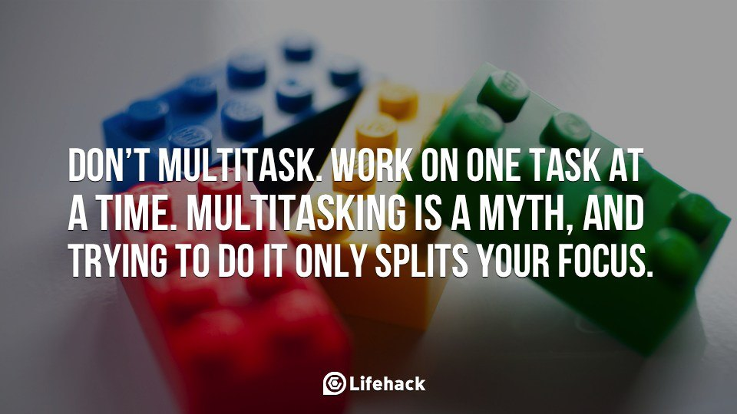
1. DON’T MULTITASK

Slide 2
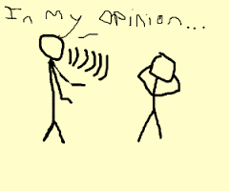
2.DON’T PONTIFICATE

Slide 3


Slide 4
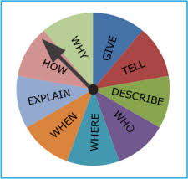
3.USE OPEN ENDED QUESTIONS

Slide 5

4.GO WITH THE FLOW

Slide 6
5.IF YOU DON’T KNOW SAY DON’TKNOW

Slide 7
6.DON’T EQUATE YOUR EXPERIENCE WITH THEIRS

Slide 8
7.TRY NOT TO REPEAT YOURSELF

Slide 9

8.STAY OUT OF THE WEEDS

Slide 10
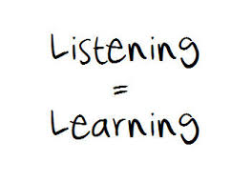
9.LISTEN

Slide 11
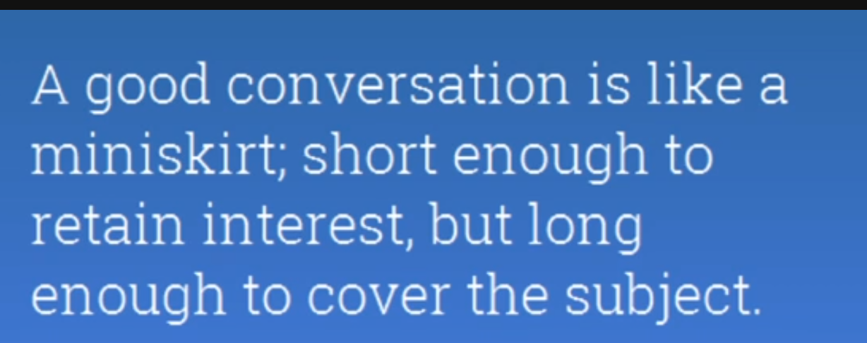
10.BE BRIEF

Slide 12
THANK YOU

